Slide 1
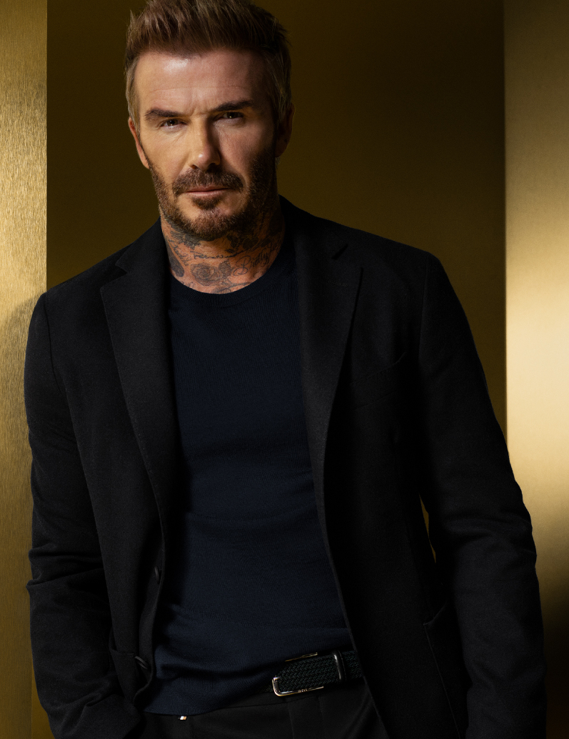
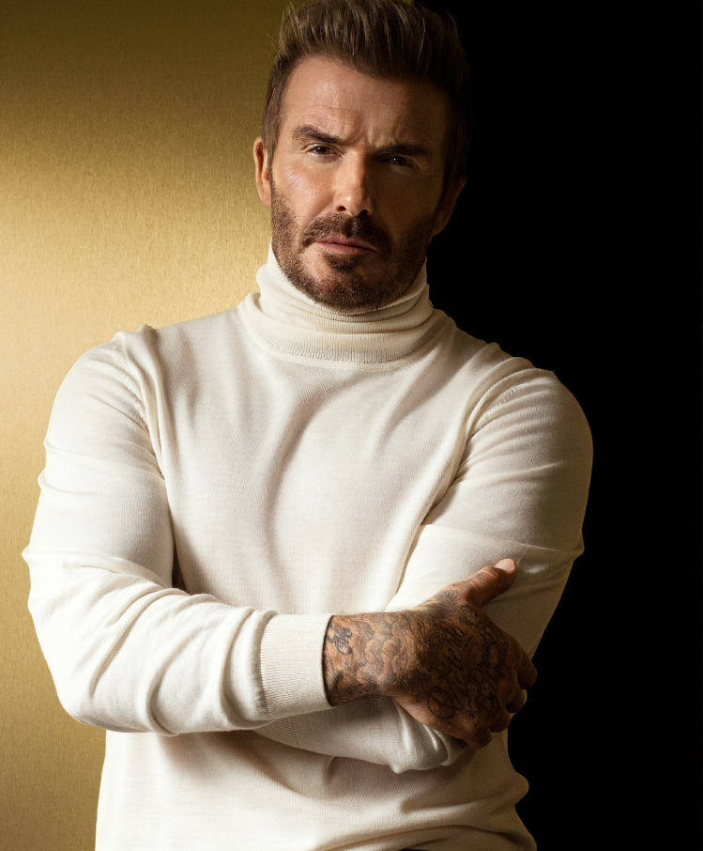


Slide 2
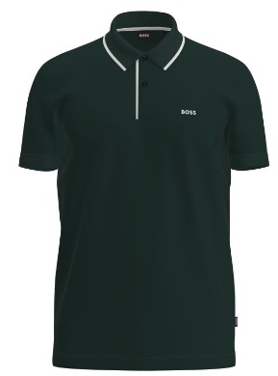
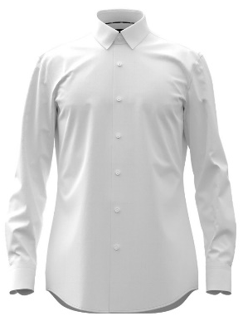
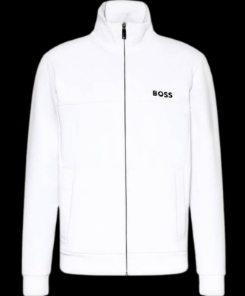
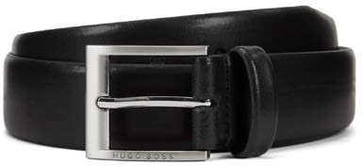
Product categories
Categories Men
POLOS
T-SHIRTS
SHIRTS
KNITWEAR
JERSEY
JEANS
BODYWEAR
SNEAKERS
BELTS

Slide 3
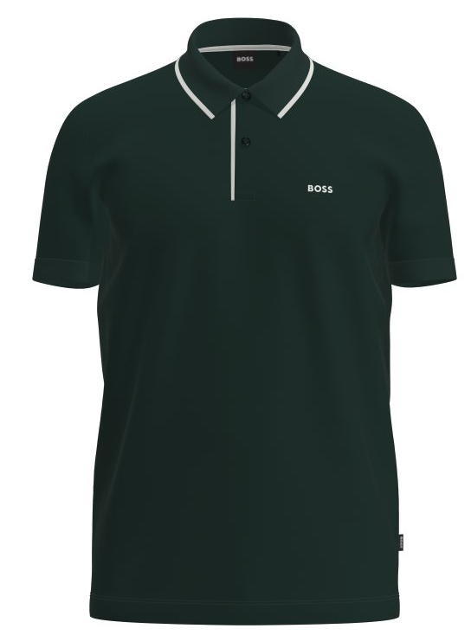




POLOS
T-SHIRTS
SHIRTS
KNITWEAR
JERSEY
JEANS
BODYWEAR
SNEAKERS
BELTS
Regular-fit cotton polo shirt with logo embroidery
Polo shirt in
cotton-blend piqué with S.Café®
Style Firenze 33– 50268712
Colour: Black, Navy, Camel, White, Dark Grey, Open Red, Open Green, Open Blue
Material Composition: 100% Cotton
RRP: 99,95 €
Outlet Price: 69,00 €
Style Paddy Pro – 50249000
Colour: Black, Navy, White
Material Composition: 65% Cotton,
35% Polyester (recycled)
RRP: 89,95 €
Outlet Price: 62,00 €

Slide 4
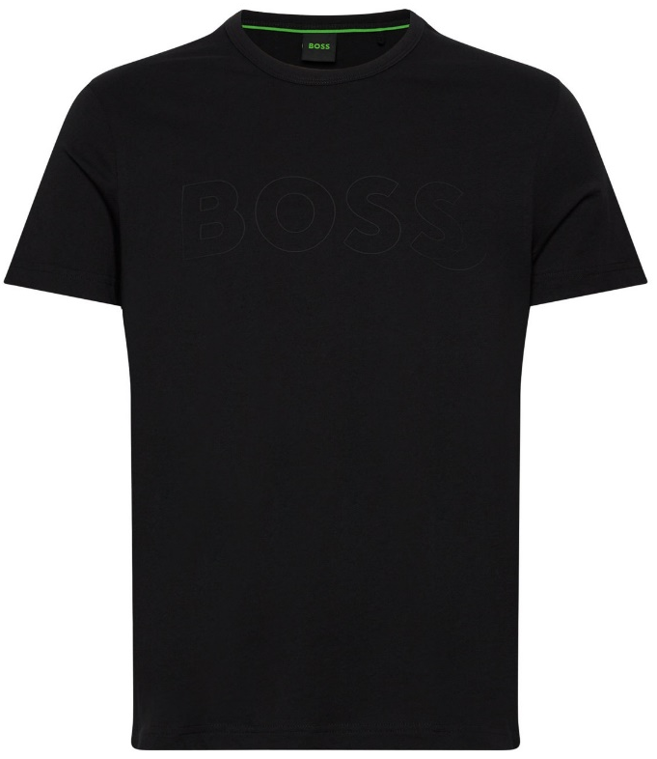



POLOS
T-SHIRTS
SHIRTS
KNITWEAR
JERSEY
JEANS
BODYWEAR
SNEAKERS
BELTS
Tonal Outline-logo T-shirt in cotton jersey
Slim-fit T-shirt with small logo in cotton jersey
Style Teebo_N – 50492057
Colour: Black, Light Grey, White, Navy, Open Blue, Bright Green, Pastel Green, Dark Yellow
Material Composition: 100% Cotton
RRP: 59,95 €
Outlet Price: 41,00 €
Style Tessler– 50321682
Colour: Black, Grey, White, Navy, Open Blue, Light Blue, Open Green, Camel
Material Composition: 100% Cotton
RRP: 59,95 €
Outlet Price: 41,00 €

Slide 5
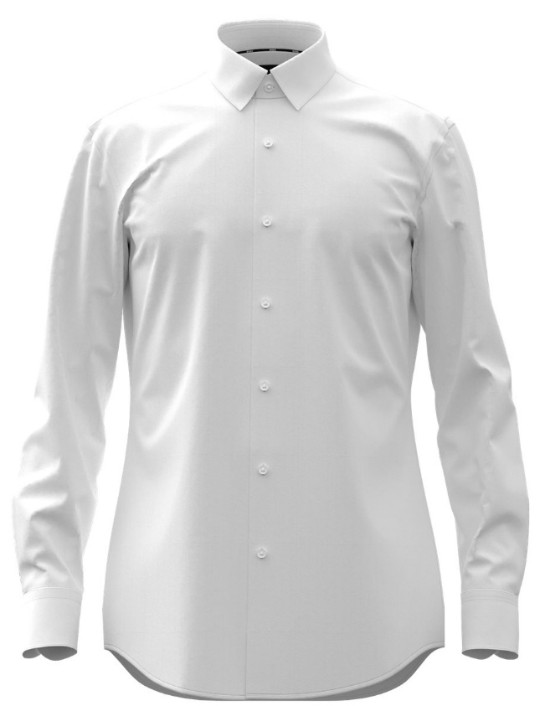
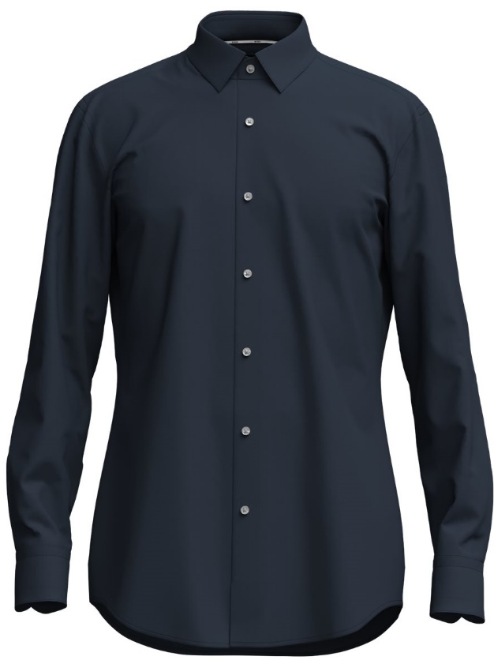



POLOS
T-SHIRTS
SHIRTS
KNITWEAR
JERSEY
JEANS
BODYWEAR
SNEAKERS
BELTS
Slim-fit shirt in easy-iron cotton poplin
Style Hank – 50500318
Colour: White, Black, Light/Pastel Blue, Dark Blue
Material Composition: 100% Cotton
RRP: 89,95 €
Outlet Price: 62,00 €
Slim-fit shirt in easy-iron cotton poplin
Regular-fit shirt in easy-iron cotton poplin
Style Joe – 50500334
Colour: White, Black, Light/Pastel Blue
Material Composition: 100% Cotton
RRP: 89,95 €
Outlet Price: 62,00 €
Style Hank – 50500318
Colour: White, Black, Light/Pastel Blue, Dark Blue
Material Composition: 100% Cotton
RRP: 89,95 €
Outlet Price: 62,00 €

Slide 6
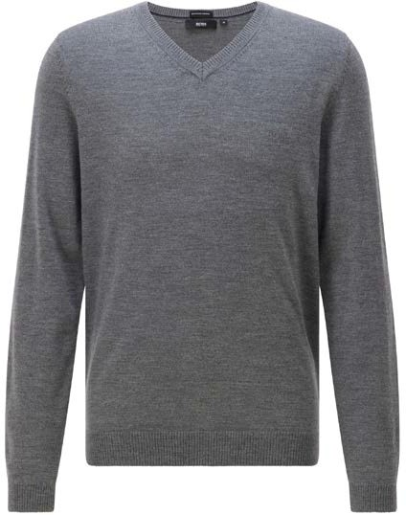
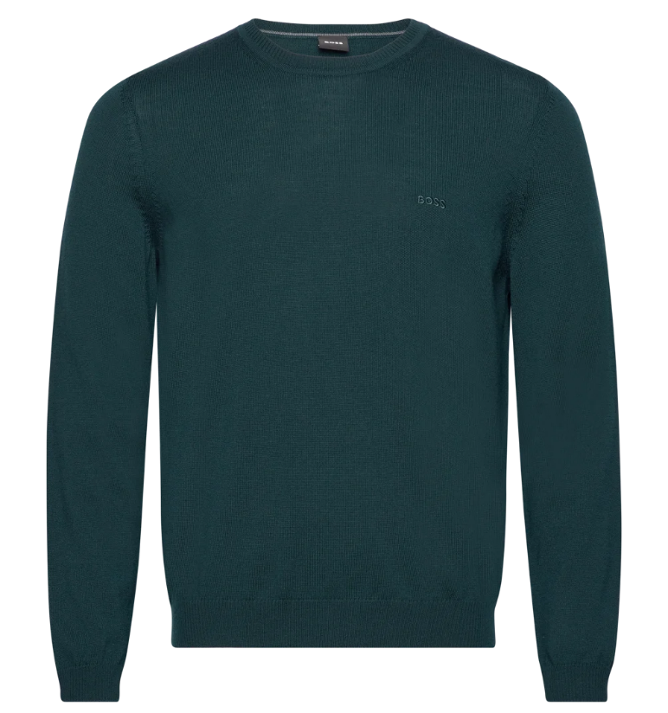
POLOS
T-SHIRTS
SHIRTS
KNITWEAR
JERSEY
JEANS
BODYWEAR
SNEAKERS
BELTS
Regular-fit V-neck sweater in extra-fine merino wool
Style Batisse-E – 50298509
Colour: Black, Medium Grey, Dark Blue, Dark Red
Material Composition: 100% Virgin wool
RRP: 129,95 €
Outlet Price: 90,00 €
Regular-fit roll-neck sweater in extra-fine merino wool
Style Baldebert-E – 50298449
Colour: Black, Medium Grey, Dark Blue
Material Composition: 100% Virgin wool
RRP: 149,95 €
Outlet Price: 104,00 €
Regular-fit extra-fine knit merino wool sweater
Style Bagritte E – 50298454
Colour: Black, Navy, Medium Grey
Material Composition: 100% Virgin wool
RRP: 139,95 €
Outlet Price: 97,00 €

Slide 7
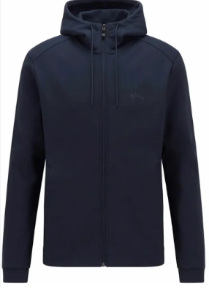
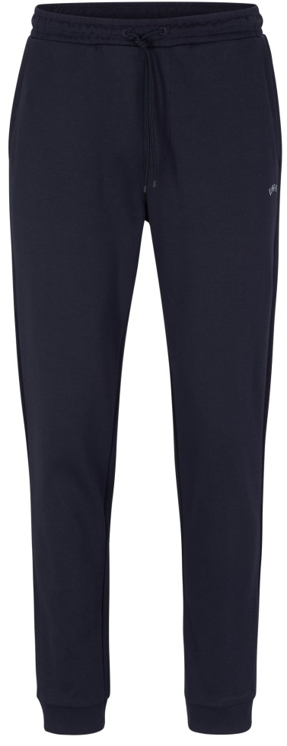
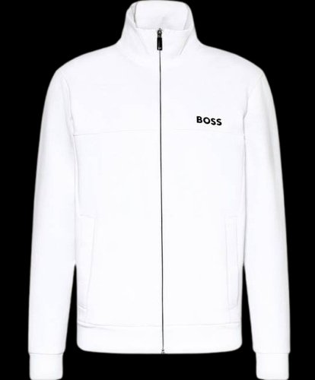
POLOS
T-SHIRTS
SHIRTS
KNITWEAR
JERSEY
JEANS
BODYWEAR
SNEAKERS
BELTS
Regular-fit cotton crewneck sweatshirt with logo
Style Salbo B – 50494453
Colour: Black, Navy, Medium Grey
Material Composition: 100% Cotton
RRP: 119,95 €
Outlet Price: 83,00 €
Regular-fit hooded cotton zip-sweatshirt with small logo
Style Saggy X – 50493732
Colour: Black, Navy, White
Material Composition: 100% Cotton
RRP: 149,95 €
Outlet Price: 104,00 €
Jogging trousers in cotton with drawstring waist
Style Hadiko X – 50493720
Colour: Black, Navy, Medium Grey
Material Composition: 100% Cotton
RRP: 119,95 €
Outlet Price: 83,00 €
Regular-fit cotton zip-sweatshirt with small logo
Style Skaz X – 50493741
Colour: White, Black, Navy, Medium Grey
Material Composition: 100% Cotton
RRP: 149,95 €
Outlet Price: 104,00 €

Slide 8
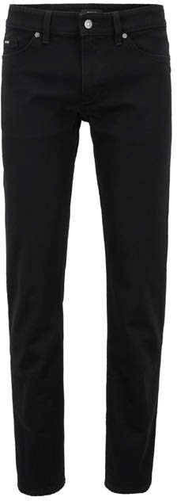
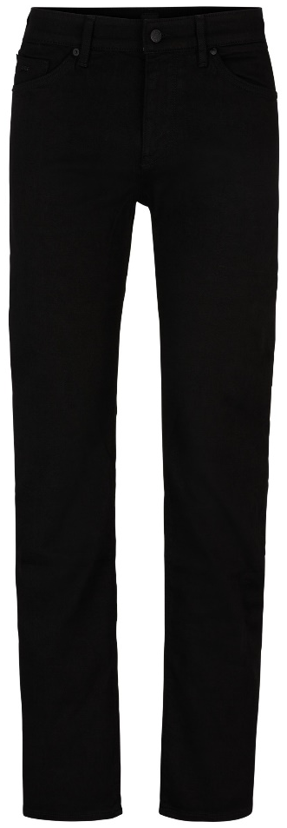
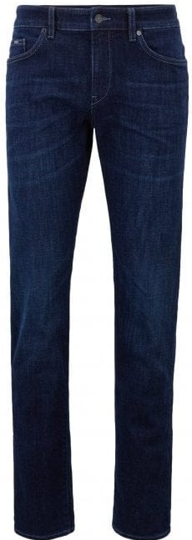
POLOS
T-SHIRTS
SHIRTS
KNITWEAR
JERSEY
JEANS
BODYWEAR
SNEAKERS
BELTS
Slim-fit jeans in deep-black stretch denim
Style Delaware3 – 50399404
Colour: Black, Dark Grey
Material Composition: 98% Cotton, 2% Elastane
RRP: 129,95 €
Outlet Price: 90,00 €
Regular-fit jeans in dark-grey stretch denim
Style Maine3 – 50399407
Colour: Black
Material Composition: 98% Cotton, 2% Elastane
RRP: 129,95 €
Outlet Price: 90,00 €
Slim-fit jeans in deep-blue stretch denim
Style Delaware3-1 – 50399404
Colour: Dark Blue
Material Composition: 98% Cotton, 2% Elastane
RRP: 129,95 €
Outlet Price: 90,00 €
Extra-slim-fit jeans in mid-blue
stretch denim
Style Charleston4 – 50463560
Colour: Navy
Material Composition: 94% Cotton, 5% Polyester, 1% Elastane
RRP: 139,95 €
Outlet Price: 90,00 €

Slide 9
POLOS
T-SHIRTS
SHIRTS
KNITWEAR
JERSEY
JEANS
BODYWEAR
SNEAKERS
BELTS
Slim-fit jeans in deep-blue super stretch denim
Style Delaware3-1 – 50491140
Colour: Dark Blue
Material Composition: 94% Cotton, 5% Polyester,
1% Elastane
RRP: 123,95 €
Outlet Price: 97,00 €
Tapered Fit Chino
aus Stretch Gabardine
Style Kaito1-D – 50425056
Colour: Dark Grey, Black, Dark Blue, Beige
Material Composition: 98% Cotton, 2% Elastane
RRP: 139,95 €
Outlet Price: 99,95 €

Slide 10
POLOS
T-SHIRTS
SHIRTS
KNITWEAR
JERSEY
JEANS
BODYWEAR
SNEAKERS
BELTS
Three-pack
of stretch-cotton boxer briefs
Style Trunk 3P Spirit – 50495236
Colour: Black, White, Open Blue, Open Miscellaneous, Assorted Pre-Pack
Material Composition: 95% Cotton, 5% Elastane
RRP: 42,95 €
Outlet Price: 30,00 €
Three-pack
of stretch-cotton briefs
Style Brief 3P Spirit – 50495226
Colour: Black
Material Composition: 95% Cotton, 5% Elastane
RRP: 39,95 €
Outlet Price: 27,00 €
Three-pack
of stretch-cotton boxer briefs
Style Trunk 3P Spirit – 50495237
Colour: Black, Assorted Pre-pack
Material Composition: 95% Cotton, 5% Elastane
RRP: 42,95 €
Outlet Price: 30,00 €

Slide 11
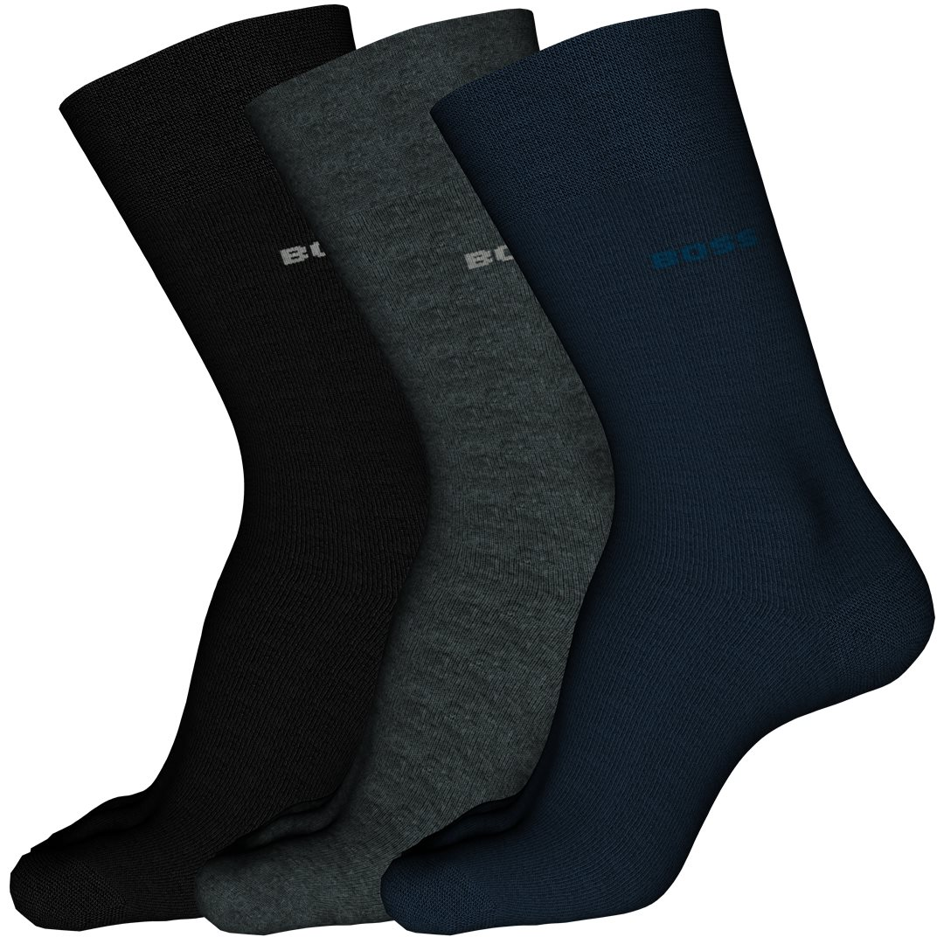
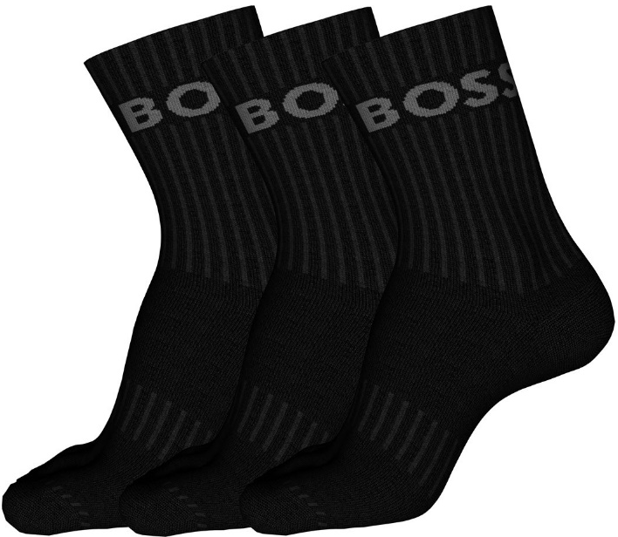
POLOS
T-SHIRTS
SHIRTS
KNITWEAR
JERSEY
JEANS
BODYWEAR
SNEAKERS
BELTS
Three-pack
of cotton-mix socks with comfort band
Style Threepack RS SP – 50274157
Colour: Black, Navy, Open Miscellaneous
Material Composition: 75% Cotton, 23% Polyamide, 2% Elastane
RRP: 13,95 €
Outlet Price: 10,00 €
Three-pack
of cotton-mix socks with comfort band
Style 3P Quarter Sock Logo – 50500343
Colour: Black, White, Open Miscellaneous
Material Composition: 78% Cotton, 20% Polyamide, 2% Elastane
RRP: 29,95 €
Outlet Price: 20,00 €
Two-pack
cotton-mix sneaker socks
Style Twopack Sneaker– 50239481
Colour: Black, White, Charcoal
Material Composition: 65% Cotton, 33% Polyamide, 2% Elastane
RRP: 12,95 €
Outlet Price: 9,00 €

Slide 12
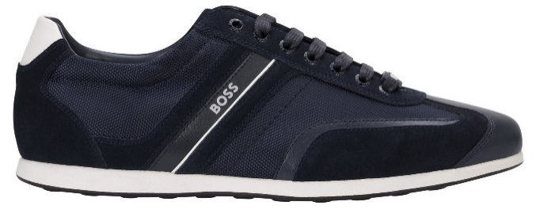
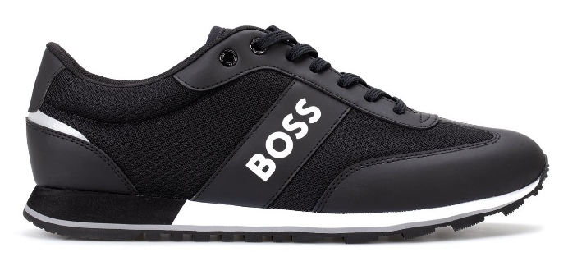
POLOS
T-SHIRTS
SHIRTS
KNITWEAR
JERSEY
JEANS
BODYWEAR
SNEAKERS
BELTS
Mixed-material trainers with rubber sole
Mixed-material trainers with rubber sole
Style Stiven – 50498281
Colour: Black, Dark Blue
RRP: 160,00 €
Outlet Price: 112,00 €
Style Parkour – 50503863
Colour: Black, White, Dark Blue
RRP: 160,00 €
Outlet Price: 112,00 €

Slide 13
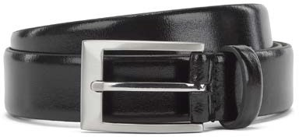
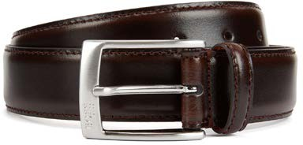
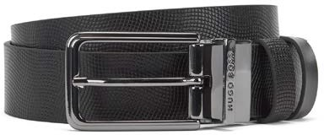
POLOS
T-SHIRTS
SHIRTS
KNITWEAR
JERSEY
JEANS
BODYWEAR
SNEAKERS
BELTS
Pin-buckle belt in smooth leather with embossed logo
Pin-buckle belt in smooth leather with engraved logo
Style Almos – 50129169
Colour: Black
Material Composition: 100% Cow skin
RRP: 70,00 €
Outlet Price: 49,00 €
Pin-buckle belt in leather with brushed silver hardware
Style Esily – 50138409
Colour: Dark Brown, Black
Material Composition: 100% Cow skin
RRP: 70,00 €
Outlet Price: 49,00 €
Reversible belt in printed and smooth leather
Style Opatrios – 50273669
Colour: Black
Material Composition: 100% Cow skin
RRP: 70,00 €
Outlet Price: 49,00 €
Style Adam – 50129166
Colour: Black
Material Composition: 100% Cow skin
RRP: 65,00 €
Outlet Price: 45,00 €

